Slide 1
Validating Form Data with JavaScript

Slide 2
Understanding Forms
Many Web sites use forms
  Collect information from users
    Transmit to a server for processing
Web page forms
  Frequently gather search criteria from a user
  Transmit data to a server-side scripting language program
Popular server-side scripting languages
  PHP, Common Gateway Interface (CGI), Active Server Pages (ASP), and Java Server Pages (JSP)

Slide 3
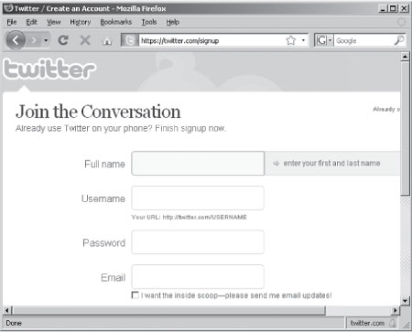
Understanding Forms (cont’d.)
Figure 1 Twitter sign-up form

Slide 4
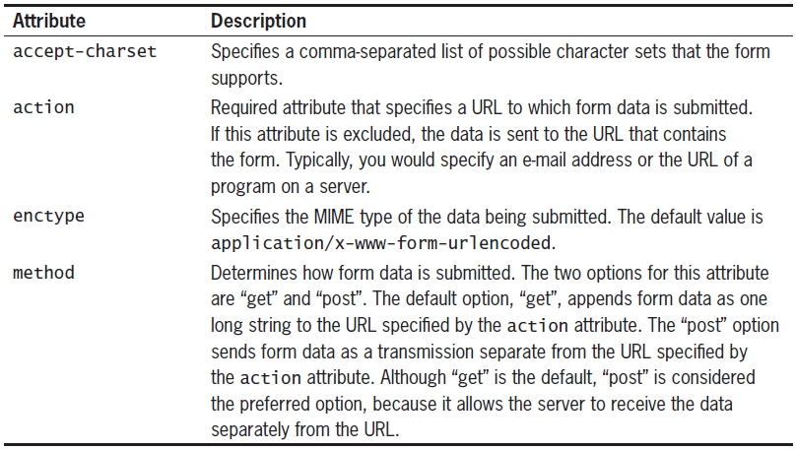
Understanding the <form> Element
<form> element
  Designates a form within a Web page
  Contains all text and elements making up a form
Notes:
Multipurpose Internet Mail Extensions

Slide 5
Understanding the <form> Element (cont’d)
Can send form data to an e-mail address
  Replace Web server script’s URL in the <form> element’s action attribute
    Use the mailto protocol
Question mark (?) use
  Append options to mailto protocol e-mail address
    to, cc, bcc, subject, body
    Options separated by commas

Slide 6
Working with Form Controls
Primary elements used within the <form> element
  <input>, <button>, <select>, <textarea>
<input> and <button> elements
  Create user interaction input fields
<select> element
  Displays choices in drop-down menu or scrolling list
<textarea> element
  Creates text field where users enter multiple lines of information

Slide 7
Working with Form Controls (cont’d.)
Field
  Form element where:
    User can enter data
    User can select or change
<input>, <textarea>, <select> elements:
  Can include name and value attributes
    name attribute defines a name for an element
    value attribute defines a default value
Example:
<input type = "text" name = "company_info"
value = "Skyward Flyers" >

Slide 8
Using JavaScript with Forms
Form object
  Represents a form on a Web page
  Used to access form controls, verify form information
  Part of the browser object model
Referencing forms and form elements
  Document object includes a forms[] array
    Contains all forms on a Web page
  <form> element’s name attribute
    Deprecated in XHTML
  Form object has an elements[] array

Slide 9
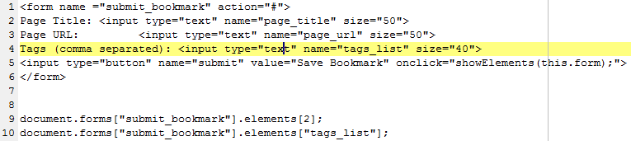
Using JavaScript with Forms (cont’d.)
elements[] array
    Contains objects representing each control in a form
Reference form index number in the forms[] array
    Followed by the appropriate element index number from the elements[] array
Form object see Tables 2, 3, and 4

Slide 10
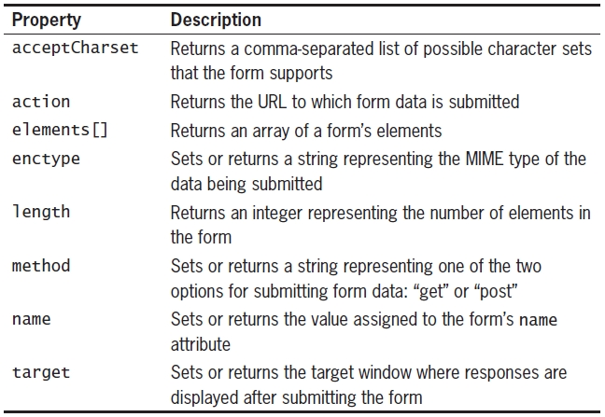
Using JavaScript with Forms (cont’d.)
Table 2 Form object properties

Slide 11
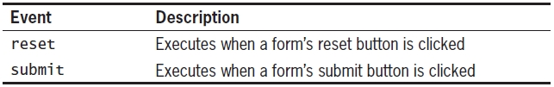
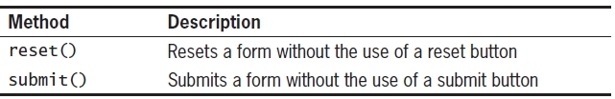
Using JavaScript with Forms (cont’d.)
Table 3 Form object events
Table 3 Form object properties
Table 4 Form object methods

Slide 12
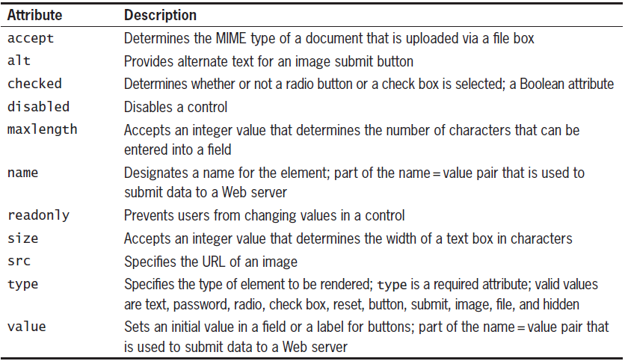
Working with Input Fields
Empty <input> element
  Generates input fields that create interface elements
    Text boxes, radio buttons, and so on
Table 5 Attributes of the <input> element

Slide 13
Working with Input Fields (cont’d.)
Examples:
checked attribute
  Boolean attribute specifying one of two values
    True or false
  <input type = "checkbox" checked = “checked”>
disabled attribute
  The disabled attribute is a boolean attribute.
  When present, it specifies that the <input> element should be disabled.
  A disabled input element is unusable and un-clickable.
  <input type="text" name="lname" disabled>

Slide 14
Working with Input Fields (cont’d.)
Most important <input> element attribute: type attribute
  Determines type of element rendered: required
  Valid type attribute values
    text, password, radio, check box, reset, button, submit, image, file, hidden

Slide 15
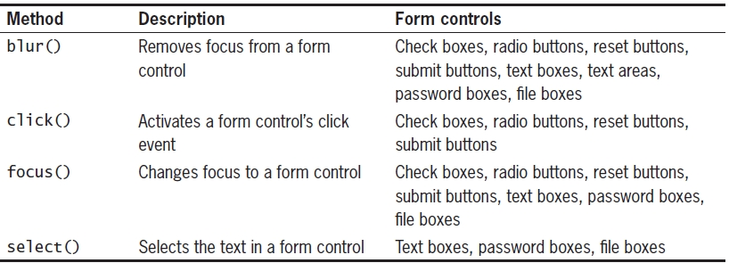
Input Field Objects (cont’d.)
Table 7 Input field object methods and their associated form controls

Slide 16
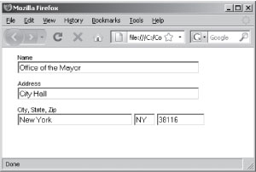
Text Boxes
Text box
  <input> element with a type of “text”
  Accepts a single line of text
value attribute
  Specifies text used as the default value at the moment a form first loads
  Form with text boxes that include value, and size attributes

Slide 17
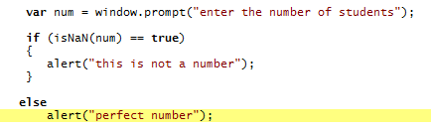
Text Boxes (cont’d.)
Form validation with JavaScript
  Takes place when form submitted
JavaScript’s built-in isNaN() function
  Determines if user entered a numeric value
  The above example is with a prompt dialog but you can validate a text box in the way

Slide 18
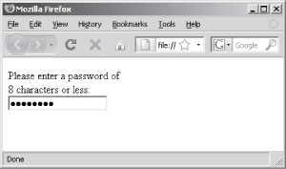
Password Boxes
Password box
  <input> element with a type of “password”
  Entering passwords or other types of sensitive data
  Character typed appears as an asterisk or bullet
Figure 3 Password box in a Web browser

Slide 19
Push Buttons
Push button
  <input> element with a type of “button”
  Similar to OK and Cancel buttons in dialog boxes
  Executes JavaScript code by performing a function
Use name and value attributes with a push button
  value attribute text appears on the button’s face
  name is the name of the button
  <input type = "button“ value=“Push Me” name=“pushbt”>
    Size of the button is dependent on the number of characters in its value attribute
  name and value attributes not required

Slide 20
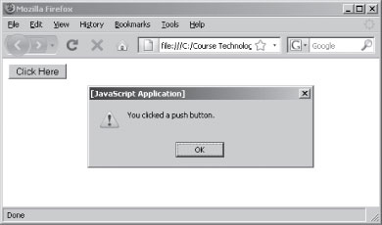
Push Buttons (cont’d.)
<p><input type = "button" name = "push_button"
value = "Click Here"
onclick = "window.alert('You clicked a push button.');" >
</p>
Figure 4 A push button in a Web browser

Slide 21
Radio Buttons
Group of radio buttons or option buttons
  <input> element with a type of “radio”
  User can select one value
All radio buttons in the group
  Must have the same name attribute
Each radio button
  Requires a value attribute identifying its unique value
Radio <input> element has a checked attribute
  Sets an initial value for the group

Slide 22
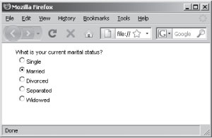
Radio Buttons (cont’d.)
Figure 5 Form with radio buttons where the second radio button has the
checked attribute set

Slide 23
Radio Buttons (cont’d.)
Multiple form elements sharing the same name
  JavaScript creates an array out of the elements using the shared name
Radio buttons share the same name
  A single name = value pair can be submitted to a server-side script
checked property returns a value of true
  If a check box or radio button selected
  Refer to handout

Slide 24
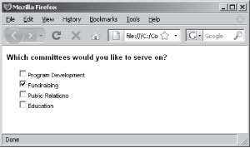
Check Boxes
Check boxes
  <input> element with a type of “checkbox”
  Can be set to Yes (checked) or No (unchecked)
  Allow users to select one, none or multiple values from a list
checked attribute
  Sets initial value of the check box to Yes
Group check boxes by giving each check box the same name value
Each check box can have a different value

Slide 25
Creating Selection Lists
<select> element creates a selection list
  Presents users with fixed lists of options
Options displayed in a selection list
  Created with <option> elements
Selection list can include a scroll bar

Slide 26
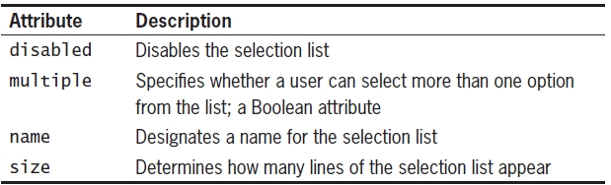
Creating Selection Lists (cont’d.)
Table 8 Attributes of the <select> element

Slide 27
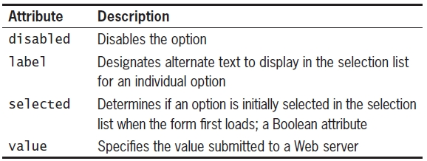
Menu Options
<option> element
  To specify a selection list’s menu options
  Use <option> elements placed within a <select> element
  Each selection list must contain at least one <option> element
Table 9 Attributes of the <option> element

Slide 28
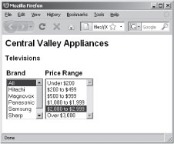
Menu Options (cont’d.)
Figure 7 Two selection lists

Slide 29
The Select and Option Objects
Select object
  Represents a selection list in a form
  Includes an options[] array containing an Option object for each <option> element in the selection list
Option object
  Represents an option in a selection list
Programmer appends properties in Table 10 to the name representing the <select> element
Programmer appends properties in Table 12 to the options[] array

Slide 30
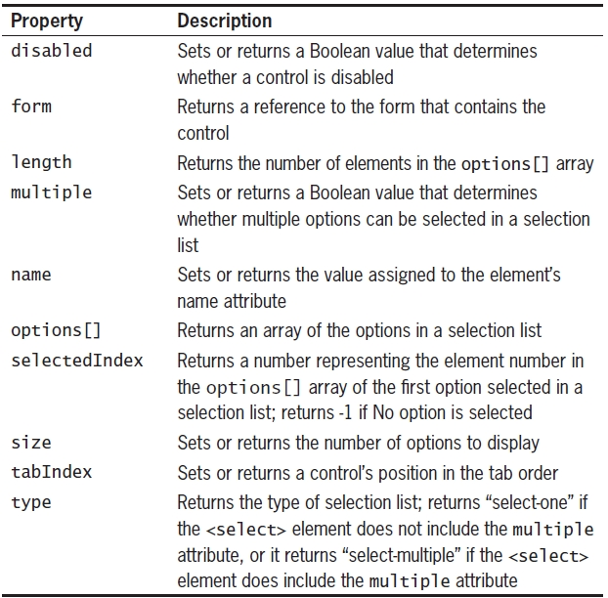
The Select and Option Objects (cont’d.)
Table 10 Properties of the Select object

Slide 31
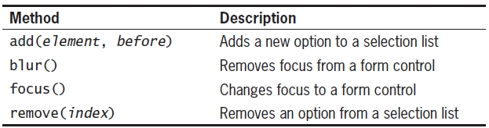
The Select and Option Objects (cont’d.)
Table 11 Methods of the Select object

Slide 32
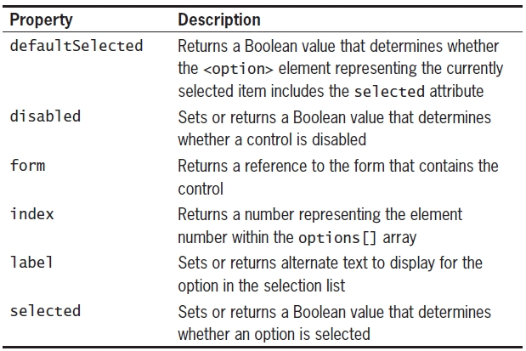
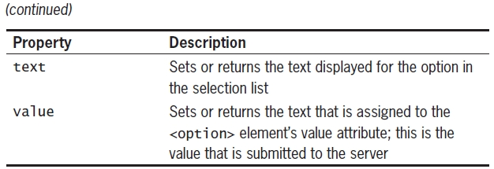
The Select and Option Objects (cont’d.)
Table 12 Properties of the Option object

Slide 33
The Select and Option Objects (cont’d.)
Events supported by the option tag
  Only Firefox seems to support the full array of mouse events, Opera is next supporting an onclick event, but in IE and Safari(win) there is no support for mouse events on options.
  Oddly enough, no browser seems to support keyboard events on options.
  So do not use the onclick event on an option to detect when the option has been selected. If you need to detect when an option has been selected or when the selection has changed in a select element, use the onchange event on the select element.
http://www.tutorialrepublic.com/html-reference/html-select-tag.php

Slide 34
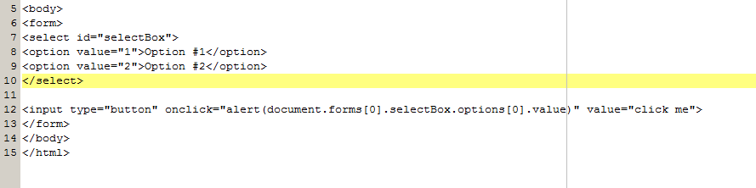
Selecting options
Display the first option in the selection box, regardless of the option selected.

Slide 35
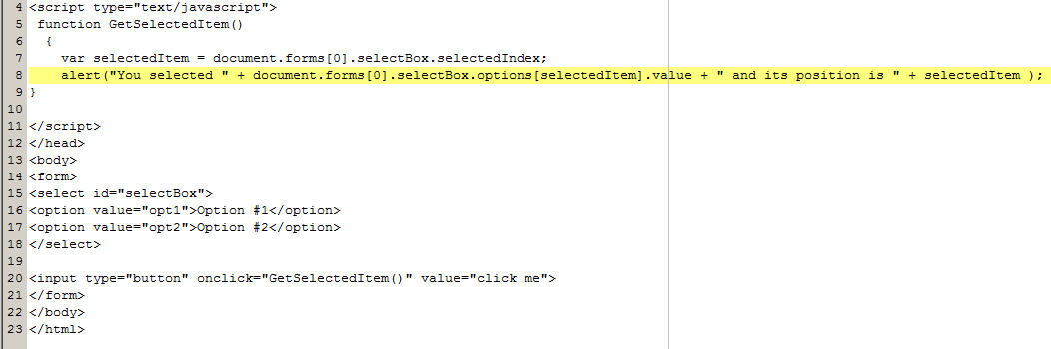
Selecting options (contd)
Display the current selected option

Slide 36
Selecting options (contd)
In a selection box that has the multiple property set or as in the example on the next slide has the size set > 1 you need to test if an option has been selected.
  The selectedIndex gives back a value of -1 if nothing has been selected or returns a number representing the position of the first selected option.

Slide 37

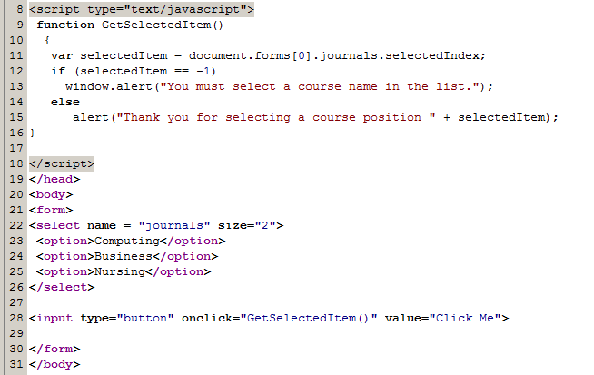
Selecting options (contd)

Slide 38
Adding Options to a Selection List
ECMAScript recommends adding new options to a selection list
  Using the add() method of the Select object
Method not consistently implemented
Create a new option with Option() constructor
  Then assign the object to an empty element in an options[] array
Syntax
var variable_name = new Option(text,value,
defaultSelected, selected);
Assigns the new element to the third element in the options array in a selection list called gardeningList

Slide 39
Removing Options from a Selection List
Pass option’s index number in options[] array to the remove() method of the Select object
  document.forms[0].gardeningList.remove(1);
  Remaining elements are reordered
Remove all the options from an options array
  Set length of options[] array to zero
    document.forms[0].gardeningList.options.length=0;

Slide 40
Validating Submitted Data
onsubmit event handler
  Executes when a form submitted to a server-side script
  Often used to verify or validate a form’s data before it is sent to a server
onreset event handler
  Executes when reset button selected on a form
  Confirm that a user really wants to reset the contents of a form
Both must return a value of true or false
  Depends if form should be submitted or reset
  <form action=“formprocessor.html” method=“post” onsubmit=“JS Statements;” onreset=“JS Statements;”>

Slide 41
Validating
Textboxes
  Use an if statement in the onsubmit event handler
  Check whether field’s value property contains a value or is a number (if that’s what is required)
Radio Buttons
  Use the checked property to determine which element in a group is selected
Check Box
  Use the checked property to determine whether an individual check box has been selected
Selection Lists
  Test whether the selection list’s selectedIndex property contains a value of minus one
    If it does, then no option selected
    This only applies where the multiple property has been set or the size is > 1, otherwise the first option is automatically selected

